Slide 1
Civic Connect – Local Public Complaint & Issue Reporting Portal
Team Name: 404notfound yet
Members name - Ronit, Rishabh, Chirag, Raj, Ashutosh.
Hackathon: Hack N Tech
Date: 23 May 2025
IIT PATNA

Slide 2
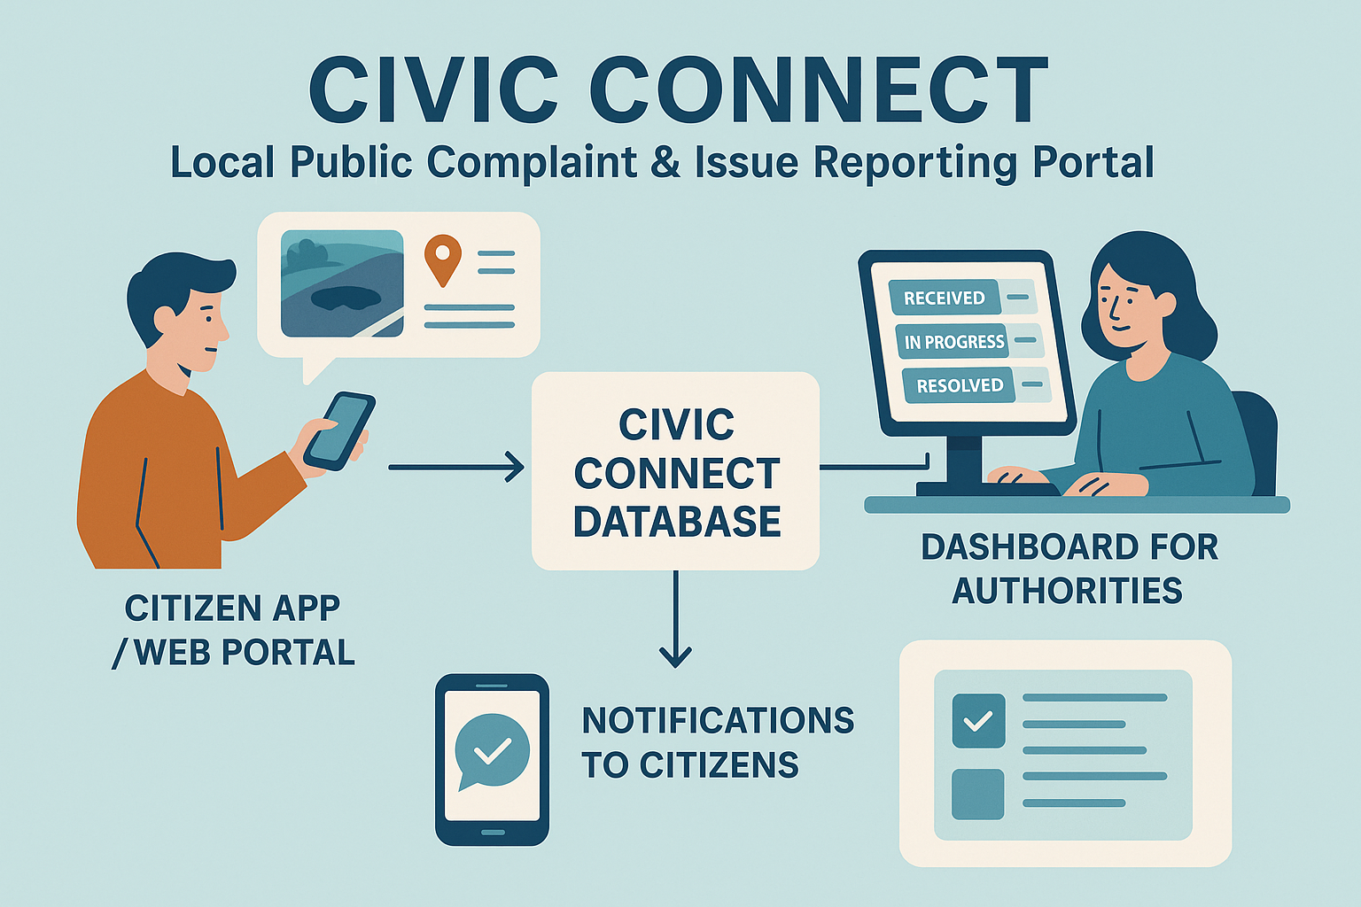

Slide 3
🚨 Problem Statement
The Problem We’re Solving
Citizens struggle to report local civic issues (potholes, broken streetlights, garbage, etc.)
Lack of centralized, accessible platform
Delayed response from authorities due to unorganized complaint channels
No transparency: Citizens can't track the status of their complaints.
Authorities can't prioritize issues efficiently.

Slide 4

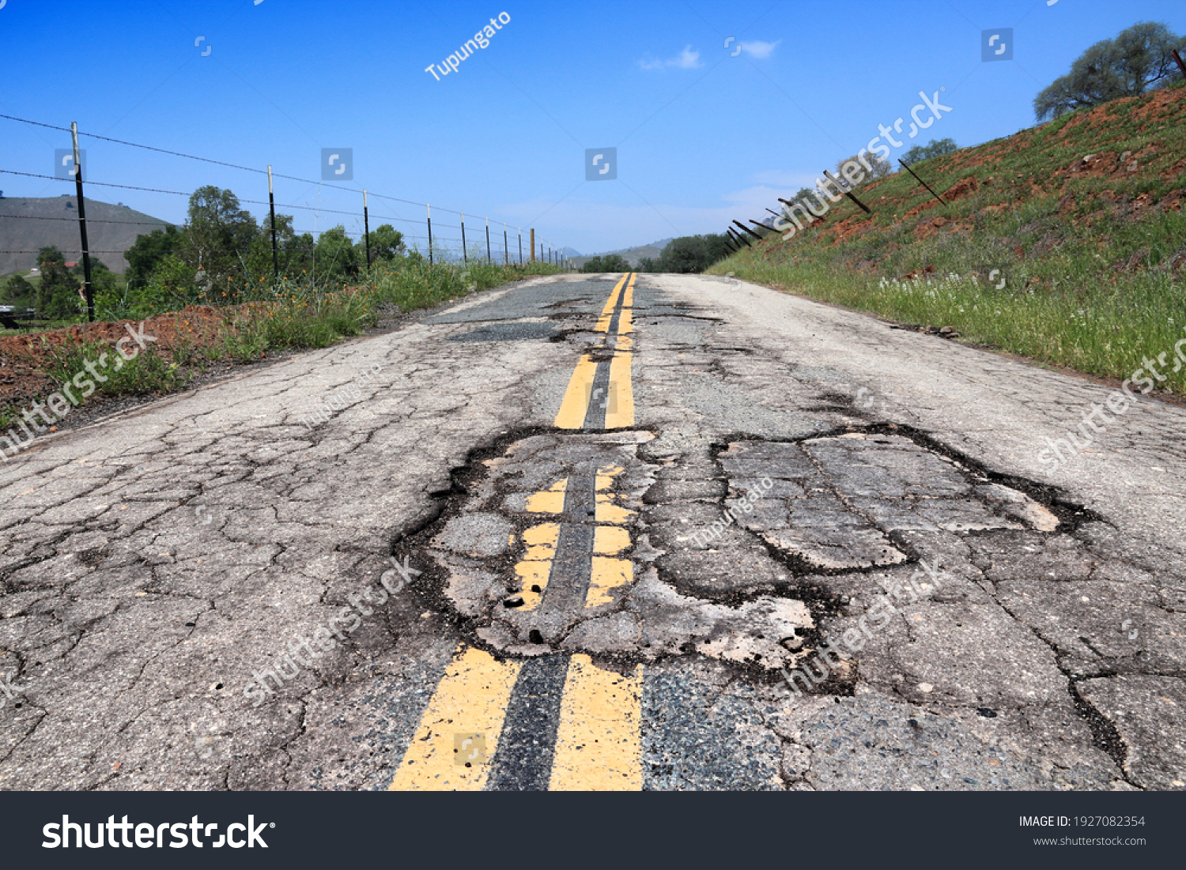

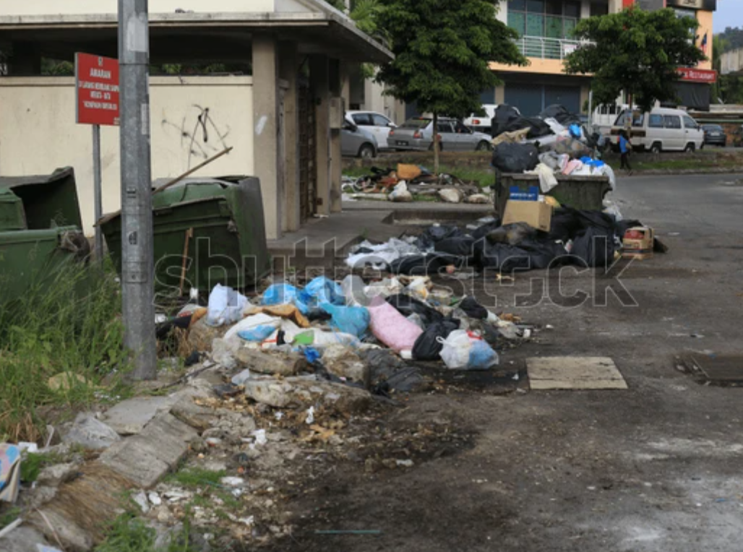
Such type of problems

Slide 5
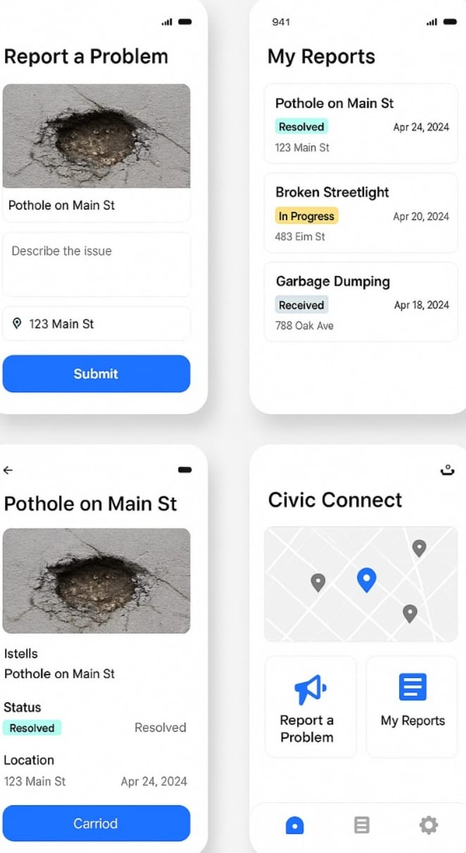
Our Solution✅
A web platform that allows citizens to:
Log complaints about local civic issues.
Upload images, select issue category, add location.
View and track complaint status.
See other complaints nearby (like a public map).
Optional: Upvote complaints to highlight urgency.

Slide 6
a simple diagram to explain the workflow:
[CITIZEN WEB PORTAL]
|
| 📸 Upload photo + 📍 Location + 📝 Description
▼
[CIVIC CONNECT DATABASE]
|
├──→ 📡 Auto-route to Relevant Dept (e.g., Roads, Sanitation)
|
└──→ 📊 Dashboard for Authorities
|
├── Track issues
├── Assign workers
└── Mark as resolved
|
▼
[NOTIFICATIONS TO CITIZENS]
(Status updates, resolution proof, feedback form)

Slide 7

🛠️ Features & Why They Matter
1.📝 Complaint Submission with Text, Image, and Location
Why it’s important:
Provides clear, accurate information about the issue.
Makes it easier for authorities to understand and prioritize.
2.📍 Geo-Tagging with Map Integration
Why it’s important:
Helps pinpoint the exact location of the issue.
Reduces time spent by authorities finding the problem area.
3. 📊 Real-Time Complaint Status Tracking
Why it’s important:
Citizens stay informed about the progres important:
Allows citizens to prioritize pressing issues. Increases visibility for common or widespread problems. 4. 🔔 Push Notifications & Alerts
Why it’s important:
Keeps users updated about status changes or required actions. Encourages active engagement from both citizens and officials.

Slide 8


Challenges & Learnings
Challenges:
Integrating maps and location tagging
Real-time status updates
Designing a user-friendly interface
Managing limited time and resources
Learnings: Hands-on with map APIs and backend integration
Improved team collaboration and problem-solving
Importance of user-centered design
Building a functional MVP under pressure

Slide 9
⚙️ Tech Stack
Frontend: HTML /CSS/Bootstrap Backend: Python/Flask /SQLite Database: PostgreSQL / MongoDB Location Services: Maps API
ML : Scikit -learn/ Pickle/ job lib

Slide 10
🚀 Future Enhancements
🧠 AI categorization of complaints.
💬 WhatsApp/SMS bot integration.
🗺️ IoT-enabled Smart City sensor support.
📲 Field Worker App with OTP verification.
🌐 Voice-based & multilingual UI.
🏆 Gamified citizen engagement.

Slide 11


